Slide 1
USER REGISTRATION SYSTEM
Using mySQL and PHP.
Submitted by: Submitted To:
K.Lakshmi Narayana. Dr.T.P Sahu sir.
Roll No: 18118030

Slide 2
INTRODUCTION
The main idea behind this project is to retrieve and store the suitable data from the users through a front-end web page using which the users are supposed to enter the valid suitable information which is needed to be filled and to be through the form.
Basically this is a simple web application using which the required data from the users is to collected by some group of employees of a company and also each employee is allocated to certain group or number of the users by their unique id known as employee id.
Finally using this web application the data from the users is collected significantly and is supposed to be stored in to the data base after which the certain required queries of are performed on the obtained data for further purposes.

Slide 3
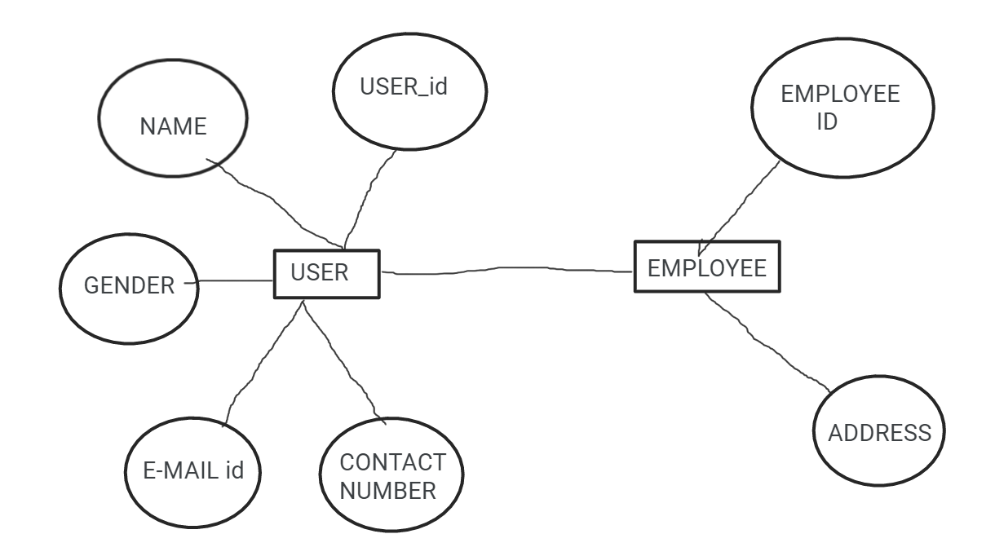
E-R Diagram

Slide 4
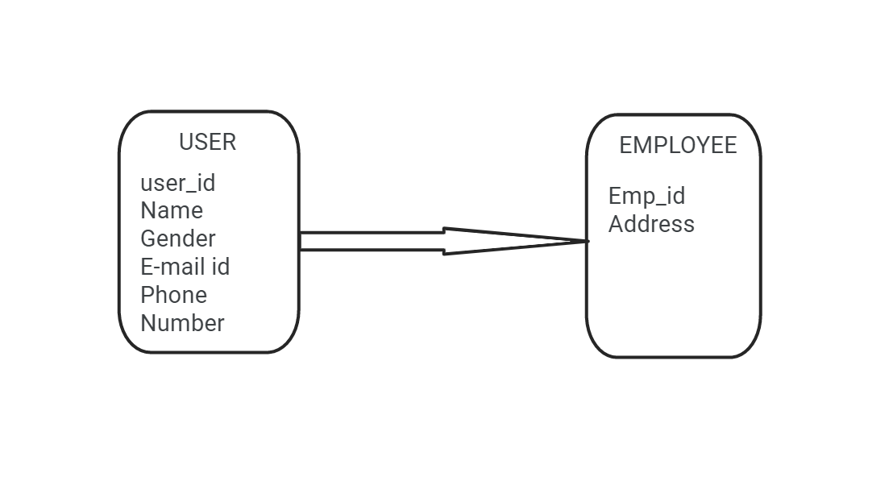
Design of Schema

Slide 5
Key Attributes
Primary Key: User_id.
Candidate Keys: Userid,E-mail id,Contact Number.
ALternate Keys: E-mail id,Contact Number.
Foreign Key: NULL

Slide 6
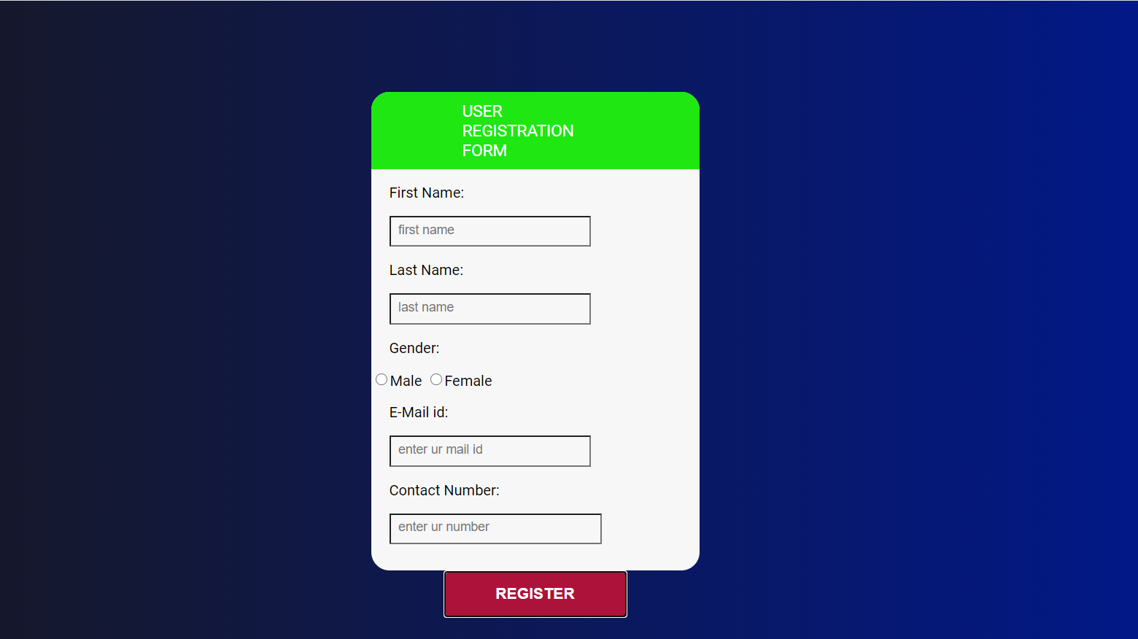
Front-End: HTML and CSS

Slide 7
BACK END: PHP and mySQL
The way front end web page interacts with the backend database for retrieval of data:
Client-side apps are usually written using a toolset of front-end languages like JavaScript, HTML and CSS. In any case, client-side applications are not usually authorized to connect directly to remote databases such as MySQL.
Instead, remote HTTP(S) backends are used to provide the client-side apps with the data they need.Therefore, to provide front-end apps with data from a MySQL database you need to implement a server-side backend and make the front-end apps use it.
Server-side backends can be written in many different languages, the most popular are PHP, Python, Node.JS, Ruby and others.In this project we have used PHP as our Server-side backend scripting language.

Slide 8
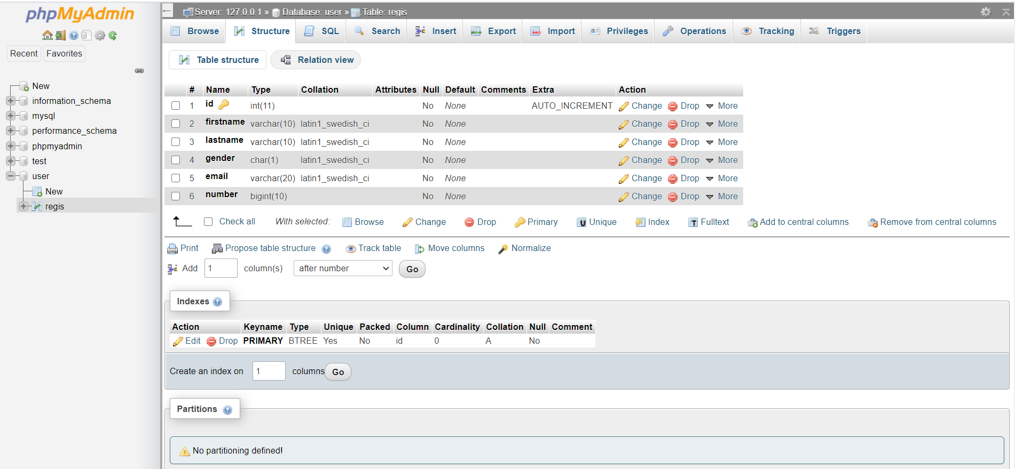

Slide 9
THE END.
.

